Slide 1










Apgar Smart Academy
Muhammad El Wazir
Taleb El Housseiny

Slide 2


LIST OF CONTENT
Introduction
Features
Database
Frontend
Backend
Database
Demo

Slide 3

INTRODUCTION
The Apgar Smart Academy project leverages advanced facial recognition technology to identify users, gather their interest preferences, and recommend tailored courses from a comprehensive database.
Making learning more intuitive and engaging for individuals by providing course suggestions that align with their unique interests.

Slide 4
Features
Identify users using Face Recognition
Recommend Courses for users based on their interests
Users log in using their face or their email and password
Admins can view all courses, delete courses, and add courses by providing a PDF file
Admin Insights: A statistical bar graph for most recommended courses

Slide 5
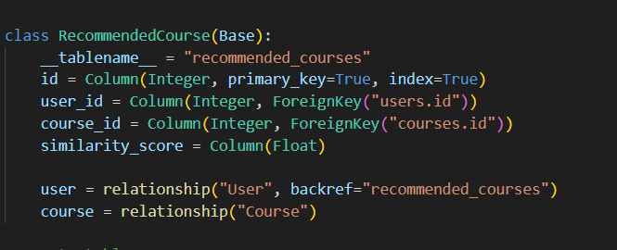
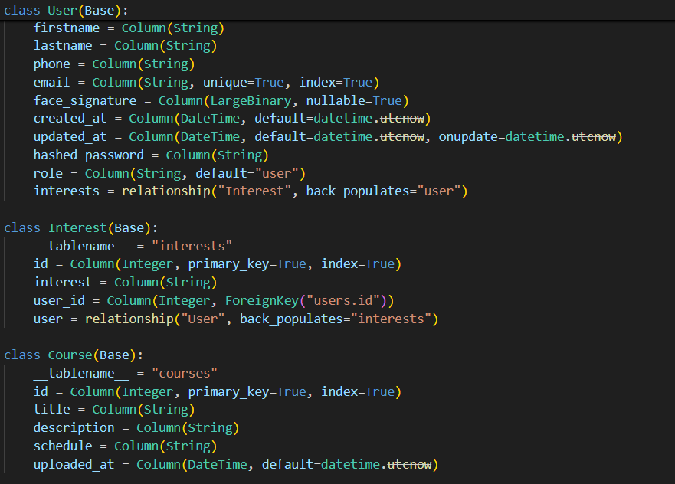
Database Table Using SQLite
View table to get recommendations fast after the second time

Slide 6
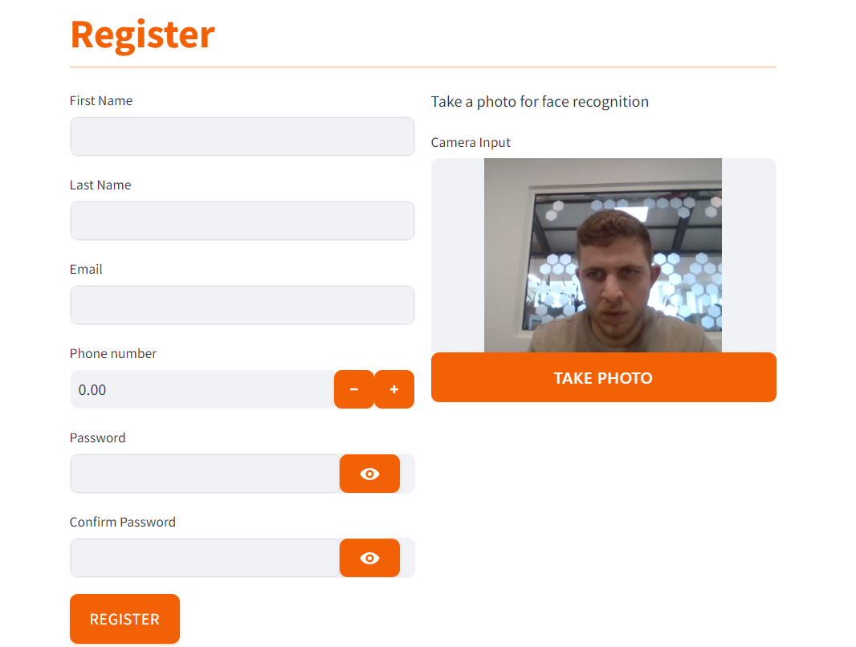
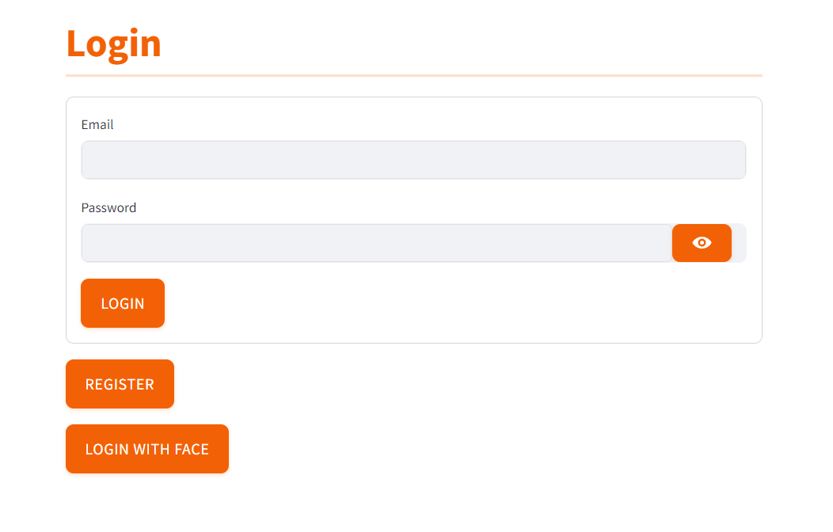
Front end using Streamlit
Login using Face or email and password

Slide 7
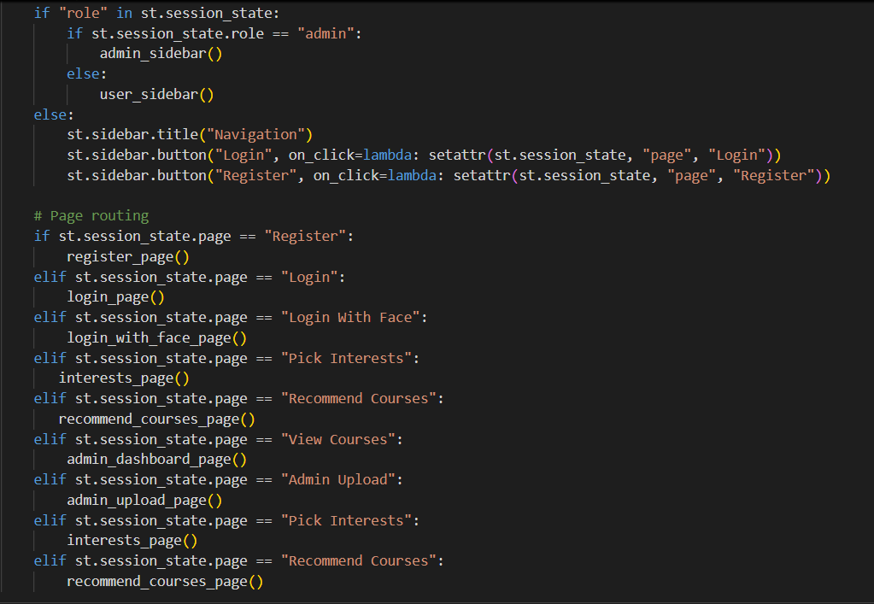
Front end using Streamlit
All routing pages in frontend

Slide 8

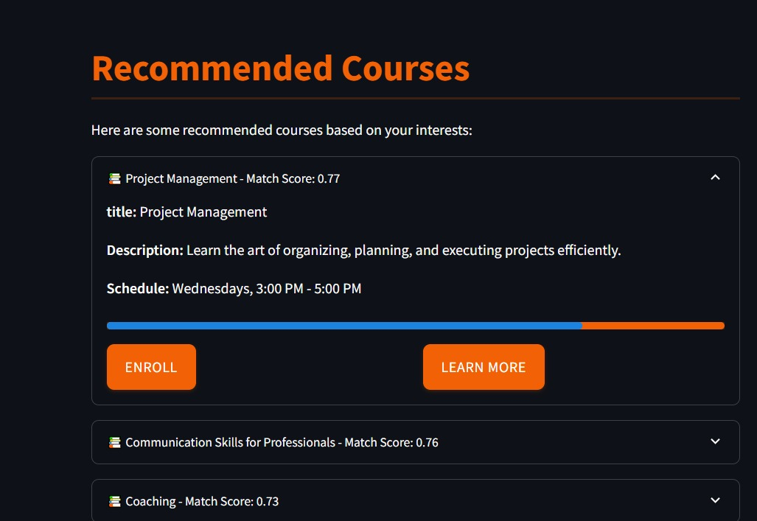
Backend using FastAPI
Recommended courses with Match score similarity

Slide 9
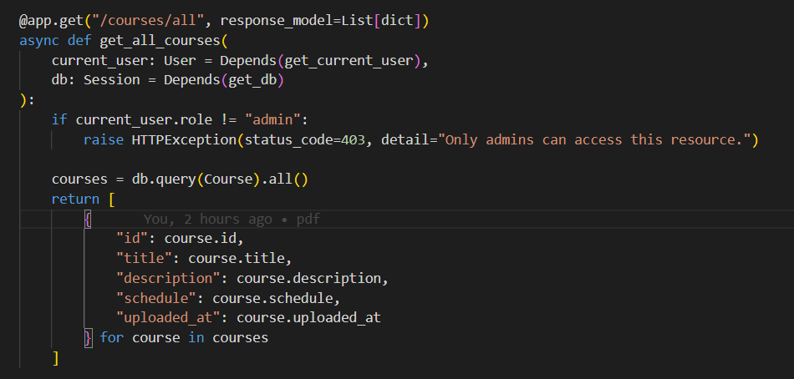
Backend using FastAPI

Slide 10
DEMO
https://github.com/MuhammadWazir/apgar_project

Slide 11
THANK
YOU

